Slide 1






FINANCIAL DOMAIN
BANK LOAN
ANALYSIS
Start
imranxdata@gmail.com

Slide 2


DOMAIN KNOWLEDGE
1.Loan Importance:Crucial for individuals and businesses; understanding terms is essential.
2.Data Collection:Gathers data from applications, credit reports, internal records, online portals, and third parties.
3.Loan Process:Involves review, verification, checks, assessment, evaluation, approval, agreement, disbursement, and monitoring.
4.Data Analysis Functions:Aids risk assessment, decision-making, portfolio management, fraud detection, compliance, insights, profitability, research, and retention.
5.Process Enhancements: Improves credit assessment, decision models, portfolio health, fraud prevention, and regulatory compliance, leading to better customer insights and retention.
imranxdata@gmail.com

Slide 3




BANK LOAN REPORT | PROBLEM STATEMENT
Key Performance Indicators (KPIs) Requirements
Good Loan v Bad Loan KPIs
Loan Status Grid View
Monthly Trends by Issue Date
Regional Analysis by State
Loan Term Analysis
Employee Length Analysis
Loan Purpose Breakdown
Home Ownership Analysis
And Many More...
imranxdata@gmail.com

Slide 4
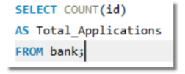
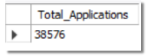
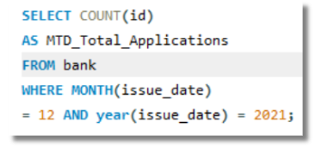
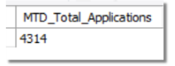
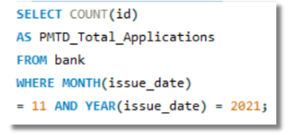
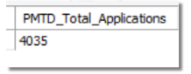
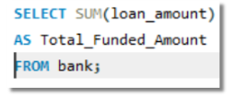
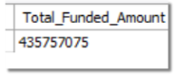
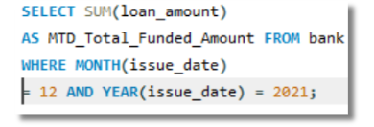
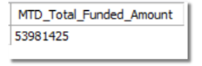
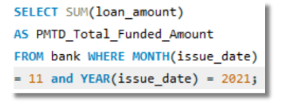
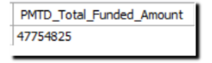
TOTAL APPLICATION | FUNDED AMOUNT
1.TOTAL LOAN APPLICATION
2.MTD LOAN APPLICATION
3.PMTD Loan Applications
4.Total Funded Amount
5.MTD Total Funded Amount
6.PMTD Total Funded Amount

Slide 5
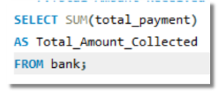
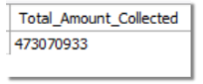
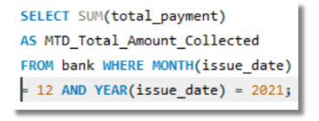
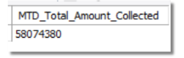
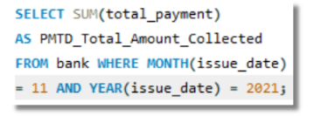
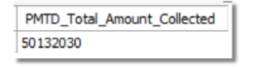
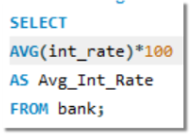
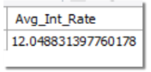
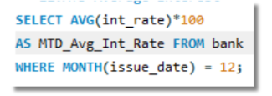
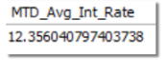
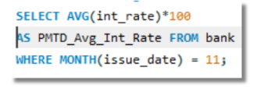
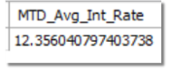
AMOUNT RECIEVED | INTEREST RATE
7.Total Amount Received
8.MTD Total Amount Received
9.PMTD Total Amount Received
10.Average Interest Rate
11.MTD Average Interest
12.PMTD Average Interest

Slide 6



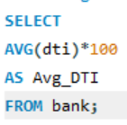
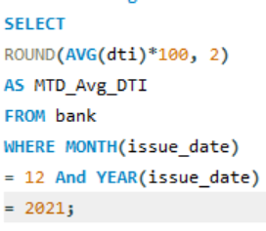
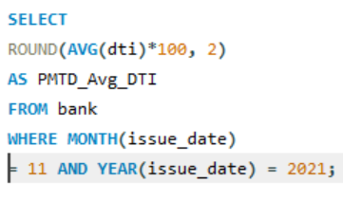
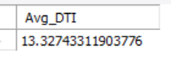
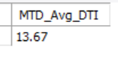
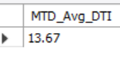

DEBT-TO-INCOME RATIO (DTI)
13.Avg DTI
14.MTD Avg DTI
15.PMTD Avg DTI
imrankhan302021@gmail.com

Slide 7
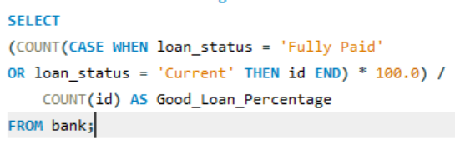
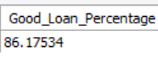
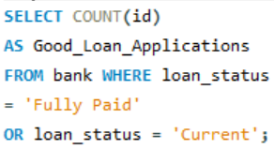
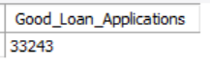
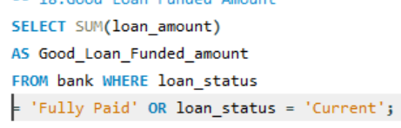
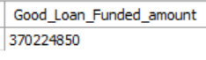
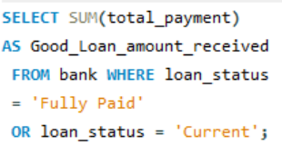
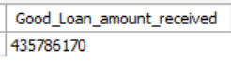
GOOD LOAN V/S BAD LOAN
16.Good Loan Percentage
17.Good Loan Applications
18.Good Loan Funded Amount
19.Good Loan Amount Received

Slide 8
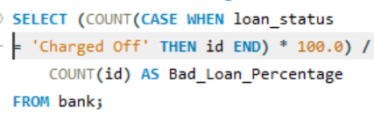
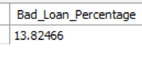
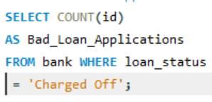
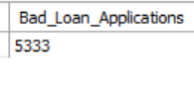
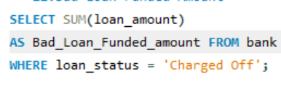
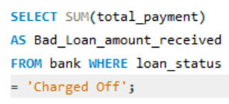
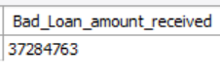
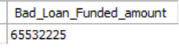
GOOD LOAN V/S BAD LOAN
20.Bad Loan Percentage
21.Bad Loan Applications
22.Bad Loan Funded Amount
23.Bad Loan Amount Received

Slide 9

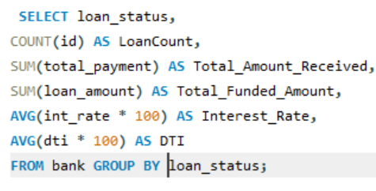
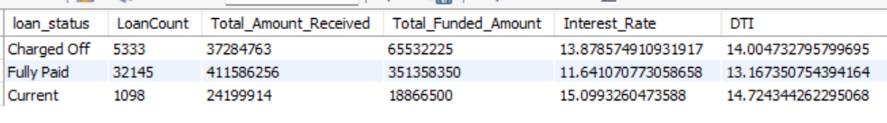
LOAN STATUS
24.Loan Performance Metrics by Status

Slide 10
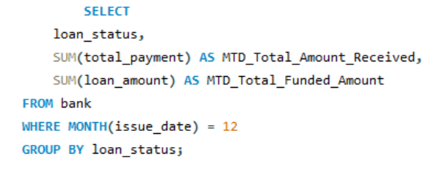
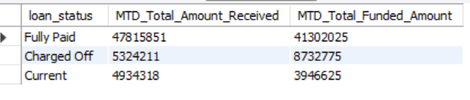
LOAN STATUS
25."Monthly Total Amount Received and Funded Amount by Loan Status

Slide 11


BANK LOAN REPORRT | OVERVIEW
26.MONTHLY TRENDS BY ISSUE DATE

Slide 12


BANK LOAN REPORRT | OVERVIEW
27.REGIONAL ANALYSIS BY STATEWISE AND TOTAL APPLICATION

Slide 13


BANK LOAN REPORRT | OVERVIEW
28.LOAN TERM ANALYSIS

Slide 14


BANK LOAN REPORRT | OVERVIEW
29.Employee Length Analysis

Slide 15


BANK LOAN REPORRT | OVERVIEW
30.Loan Purpose Breakdown

Slide 16


BANK LOAN REPORRT | OVERVIEW
-- 31.Home Ownership Analysis
imranxdata@gmail.com

